Slide 1
Exploratory Data Analysis: Flight Prices
Done by Ga fellows:
Yusuf AlDamami
Khadija Khamis
Ahmed AlSaeed

Slide 2

Project Overview
Objective: Uncovering pricing patterns and actionable insights from Expedia flight data in May 2022.
Focus: Top airports, day of the week effects, Cheapest daily fare.

Slide 3

Info of the data available
5 million flight records collected from Expedia from Kaggle
Focused EDA on May 2022 2.87M flights
Coverage: All U.S. domestic flights
Mean Base Fare: $303.20
Mean Total Fare: $351.63
Median Base Fare: $273.49

Slide 4

Next up Exploratory Data Analysis
With a large focus on the month of May

Slide 5
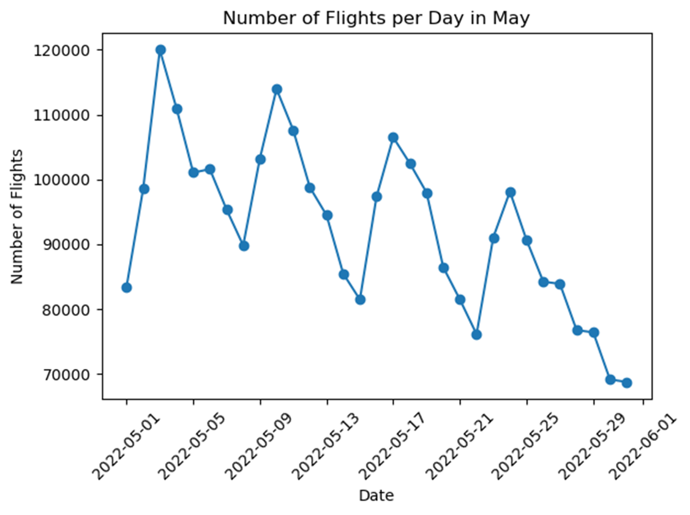
Number of Flight per Day in May
Notes:
Original chart from notebook: top airports by departures.

Slide 6
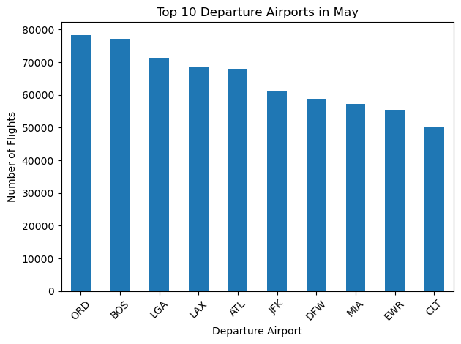
Top 10 Departure Airports in May

Slide 7
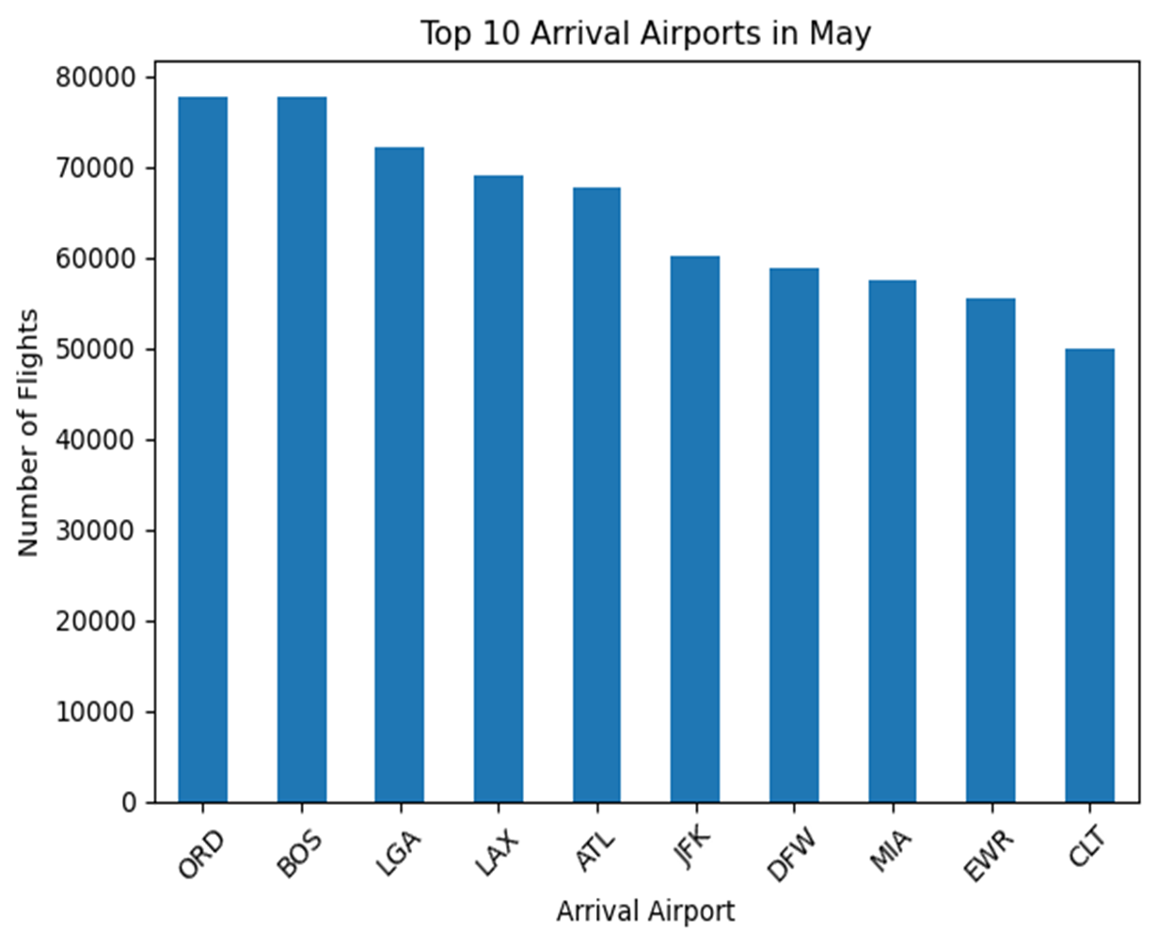
Top 10 Arrival Airports in May

Slide 8
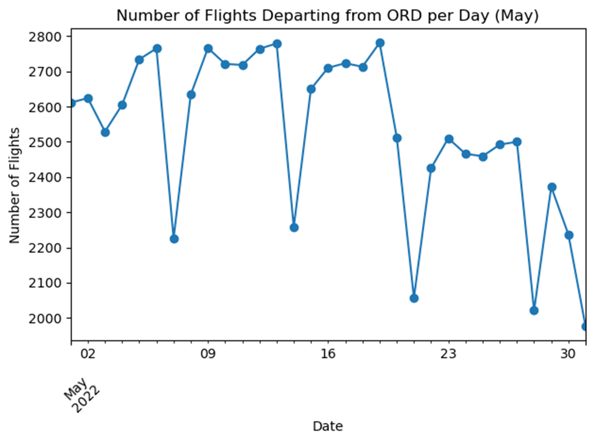
Number of Flights Departing from ORD per Day (May)

Slide 9
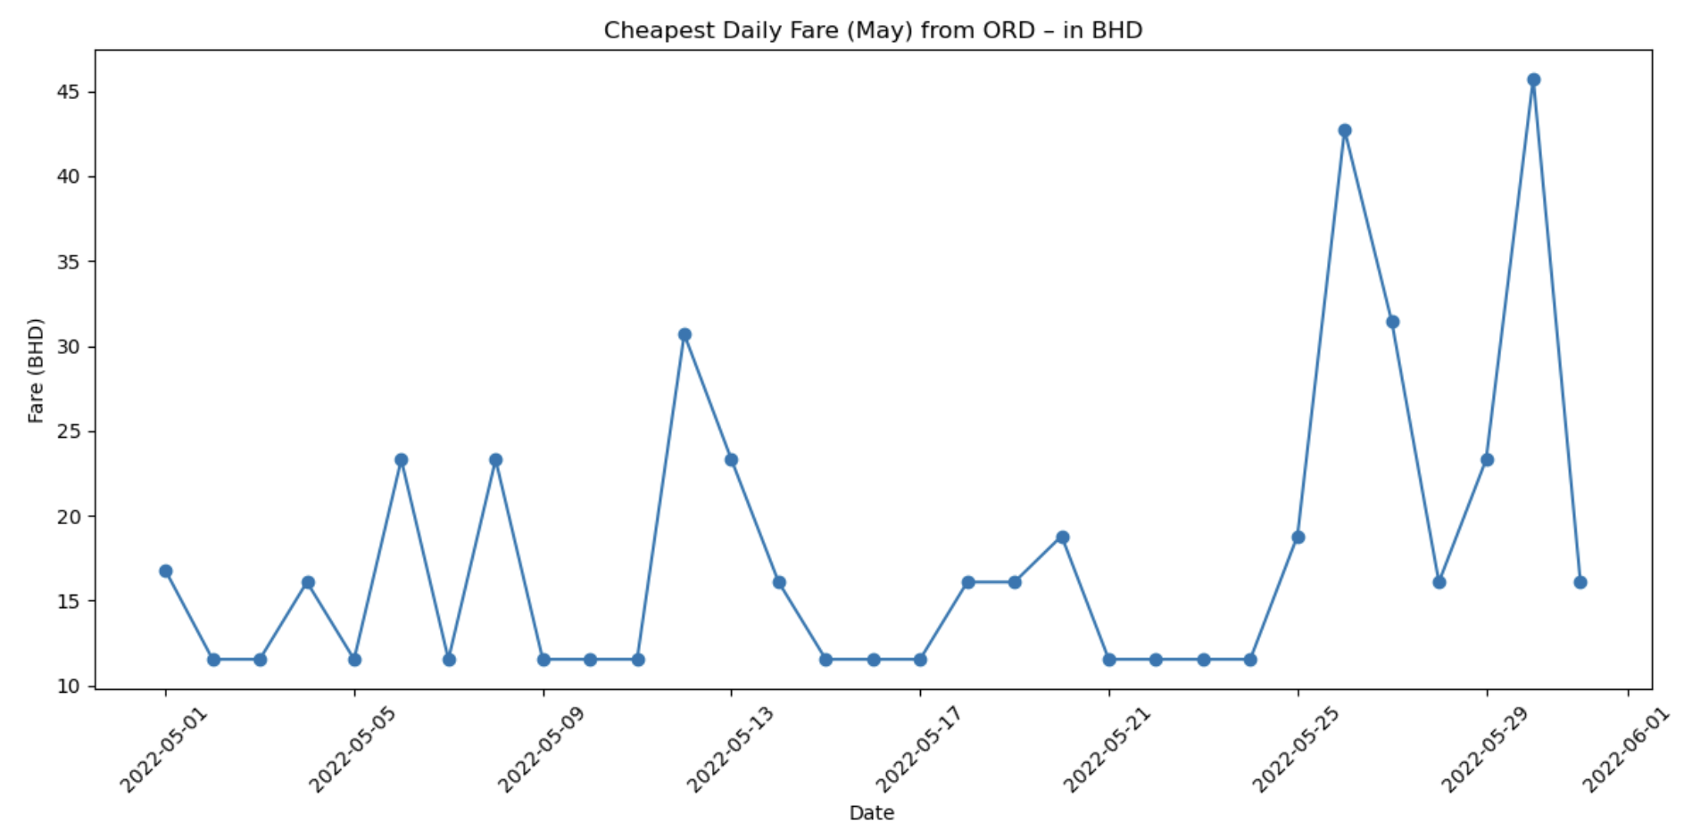
Cheapest Daily Fare (May) from ORD – in BHD

Slide 10
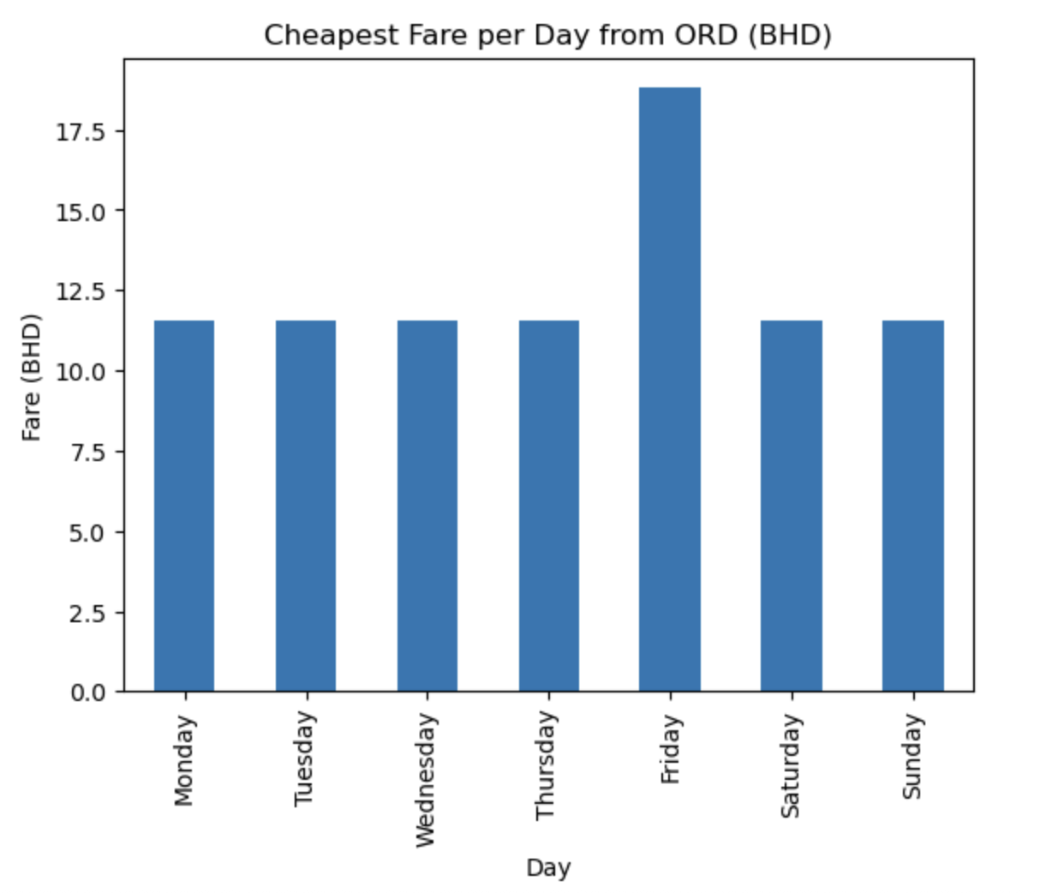
Cheapest Fare per Day from ORD (BHD)

Slide 11

Thank you for listening 😊 Any questions?

